Slide 1
Website design proposal
Brave Technologies & Trading
(BraveTech)
BT&T
www.bravetech-trading.com ou www.bravetech.com

Slide 2
Home page
Company address
Registratio ndetails
Legal details
Company Logo
Acronym
Language:
English
Francais
Banner 1: Industrial Automation
Festo
Banner 2: Process and Level Control
Vega
Banner 3: Thermal and Vibration Analysis
Fluke
Banner 4: Camera Surveillance and Security
BanoVision

Slide 3
Company address
Registratio ndetails
Legal details
Company Logo
Acronym
Language:
English
Francais
Banner 1: Industrial Automation
Festo
Motto
History
Home
Abouts Us
We believe …
VISION
MISSION
VALUES
Products
Services
Contact Us

Slide 4
Company address
Registratio ndetails
Legal details
Company Logo
Acronym
Language:
English
Francais
Banner 1: Industrial Automation
Festo
Motto
Industry Segmentation
Home
Abouts Us
Products
Partners
Services
Contact Us

Slide 5
Company address
Registratio ndetails
Legal details
Company Logo
Acronym
Language:
English
Francais
Banner 1: Industrial Automation
Festo
Motto
FESTO
VEGA
FLUKE
Home
Abouts Us
Products
Services
SWIFT
BanoVision
Accessories
Contact Us

Slide 6
Company address
Registratio ndetails
Legal details
Company Logo
Acronym
Language:
English
Francais
Banner 1: Industrial Automation
Festo
Motto
Pneumatic Energy Efficient & Saving
Installation
&
Commissionning
Home
Abouts Us
Products
Services
Sales / Support
Training
Contact Us

Slide 7
Company address
Registratio ndetails
Legal details
Company Logo
Acronym
Language:
English
Francais
Banner 5: Digital Communication & Platform
Motto
Full Name
Contact Info
Address
Phone
Email
NRC
VAT
Facebook
LinkedIn
Twitter
Home
Occupation / Position
Company
Abouts Us
Email address
Products
Telephone
Topics
Services
Message Text
Contact Us
Submit

Slide 8
Company address
Registratio ndetails
Legal details
Company Logo
Acronym
Language:
English
Francais
Banner 1: Industrial Automation
Festo
Motto
Product Catalogue
Home
Abouts Us
Products
Services
Contact Us

Slide 9
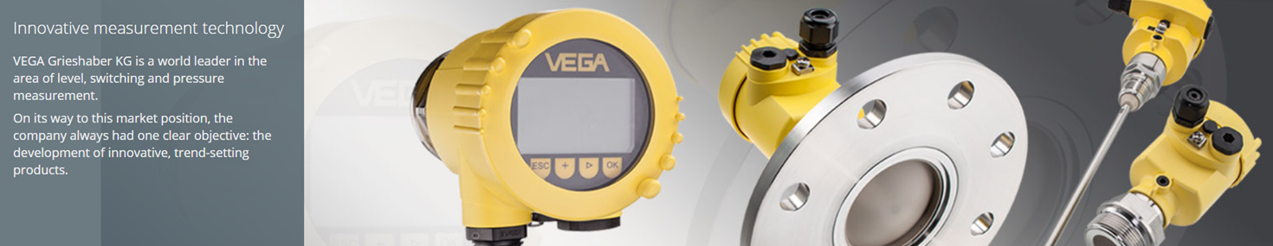
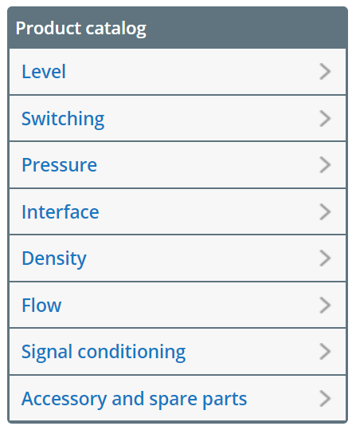
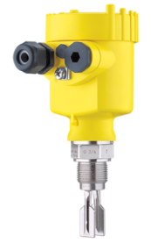
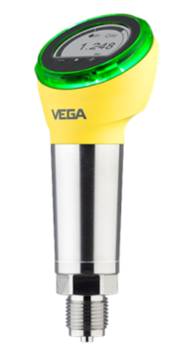
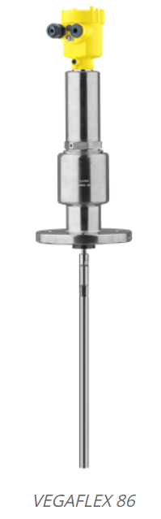
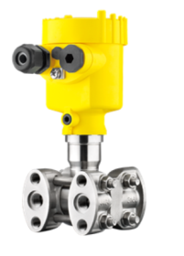
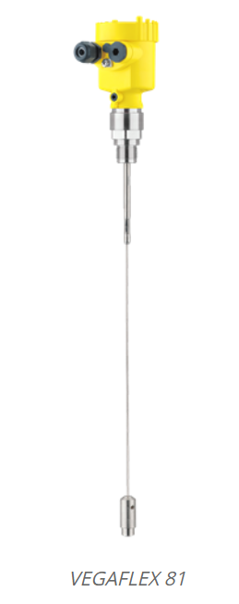
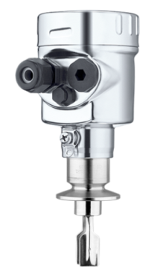
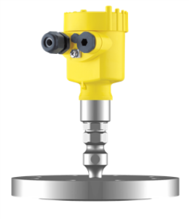
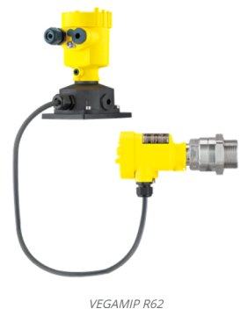
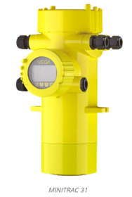
Production processes are becoming ever more complex. So it’s really important that the measurement technology used to control and monitor the processes is all the more understandable and intuitive. VEGA has set itself the goal of developing innovative measurement technology that is easy to install and operate and offers maximum safety and reliability.

Slide 10

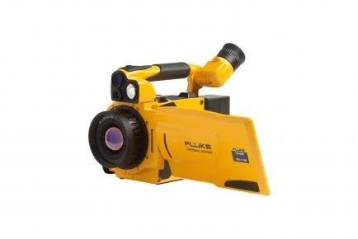
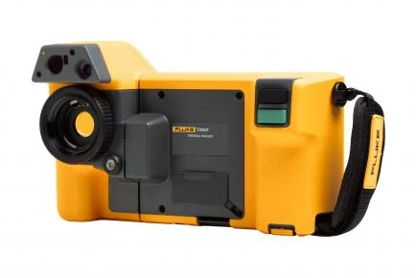
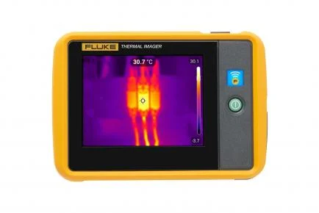
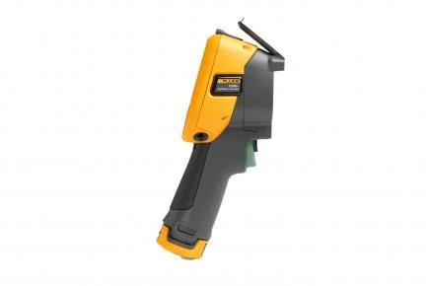
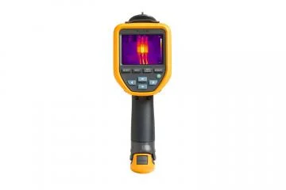
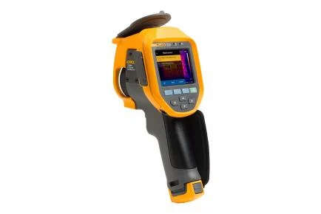
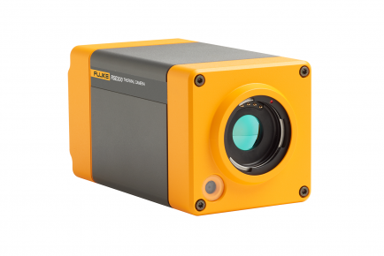
Get the infrared tools that are built on 65+ years of industrial experience. Each camera or IR windows is built without compromise to the Fluke standard of “ruggedness, reliability and accuracy”. Designed for everyday use, in any environment for thorough and accurate inspections. For infrared cameras, choose from handheld and fixed mount tools. The affordable and versatile Performance Series, the Professional Series that offers superior image quality and patented autofocus systems, or the Expert Series that gives you up to 1024 x 768 resolution on the industry’s largest screen. Explore the IR windows offerings to increase safety in your facility, or pick an infrared camera + gas detector combo tool for easy outdoor troubleshooting

Slide 11
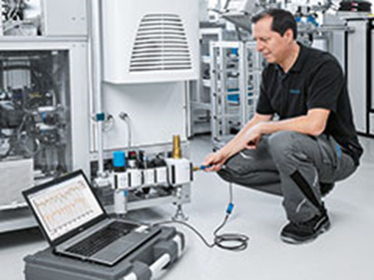
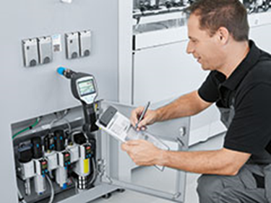
Pneumatic Energy Efficient & Saving
High energy prices, rising cost pressure and a growing awareness of climate protection have turned energy efficiency into a key productivity task. BraveTech Services offer compressed air users a customised range of services and analysis on : Compressed air generation, Air quality, Pressure measurement, Leakage detection & elimination, Air Consumption and machine efficiency for identifying and optimally exploiting potential compressed air savings – systematically and sustainably.
Increased production capacity
Prevention of unplanned production downtime
A more stable production process
Fewer rejects thanks to constant optimized production quality
Maintenance of an optimised machine statusMeasurement during operation
Establishing the actual compressed air consumption of individual machines
Systematic review of the system’s pneumatic energy efficiency
Documentation of the analysed compressed air applications
On request: installation and commissioning of the developed solution
Falling energy costs
More efficient compressed air generation
Reduced compressed air consumption
Avoidance of pressure drops due to leakagesIncreased service life of pneumatic components
Detailed list of required repair measures, including replacement parts
Systematic review of the system’s pneumatic energy efficiency
On request: installation and commissioning of the developed solutions

Slide 12
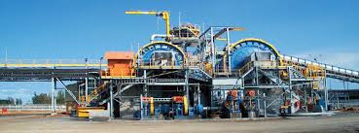
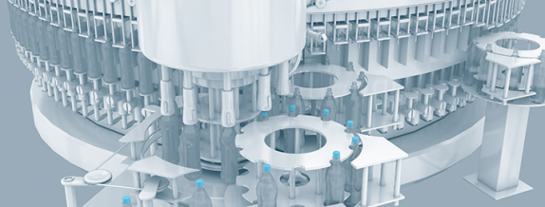
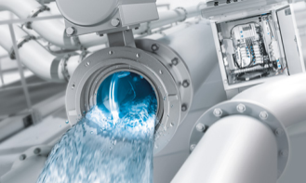
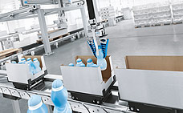



Industry segmentation
BraveTech offers its expertise and service in energy effcience through ensuring an optimised productivity across a wide range of industrial sector in manufacturing, and processing such as in Mining, Water treatment, Cement, Automotive, Packaging, Power generation, Textile, Food & Beverages.
Our Partners
BraveTech has ties with reputable brand and partners around the world to ensure adequate service & support to local market.

Slide 13
Our Values
We are Brave: Our ambition sets our courage to never gives up
We are Reliable: we Deliver beyond expectation
We Evolve* : Innovation is our focus
We are Dynamic : Hand-on approach to site services
We are BRAVETECH !
Our Mission
We are your prefered partner in supplying , installing and commissiong for industrial automation solutions. With passion for Africa’sindustrial development ; we foster production growth through cost effective services.
Our Vision
We inspire and support Africa’s industrial development in providing optimized solutions and technical support that ensure continous productivity.

